Slide 1
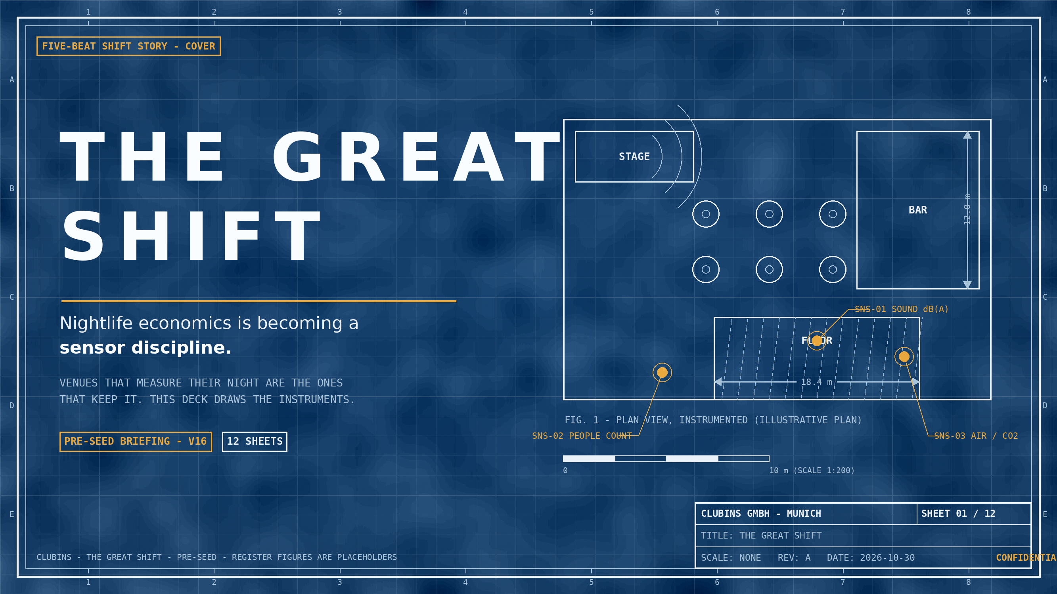
Notes:
COVER - FIVE-BEAT SHIFT STORY. THE ANGLE: NIGHTLIFE ECONOMICS IS BECOMING A SENSOR DISCIPLINE; VENUES THAT MEASURE THEIR NIGHT ARE THE WINNERS. MARKET FIGURES COME FROM THE SOURCED FACTS DOC; COMPANY FIGURES ARE REGISTER PLACEHOLDERS. DOCTRINE CITATION IN THE APPENDIX NOTE (SHEET 12).

Slide 2
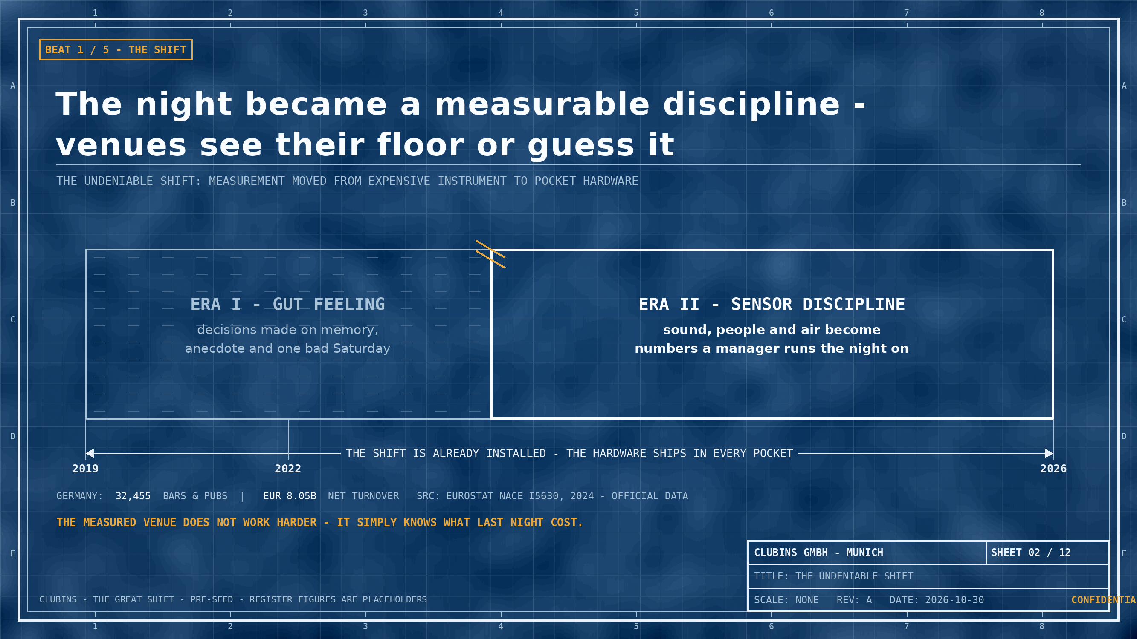
Notes:
BEAT 1 - NAME THE UNDENIABLE SHIFT. FACTS: 32,455 BARS & PUBS AND EUR 8.049B NET TURNOVER (EUROSTAT NACE I5630, 2024, VIA VERIFIED MARKET SIZE) - OFFICIAL DATA. ERA LABELS ARE NARRATIVE FRAMING, NOT DATED CLAIMS.

Slide 3
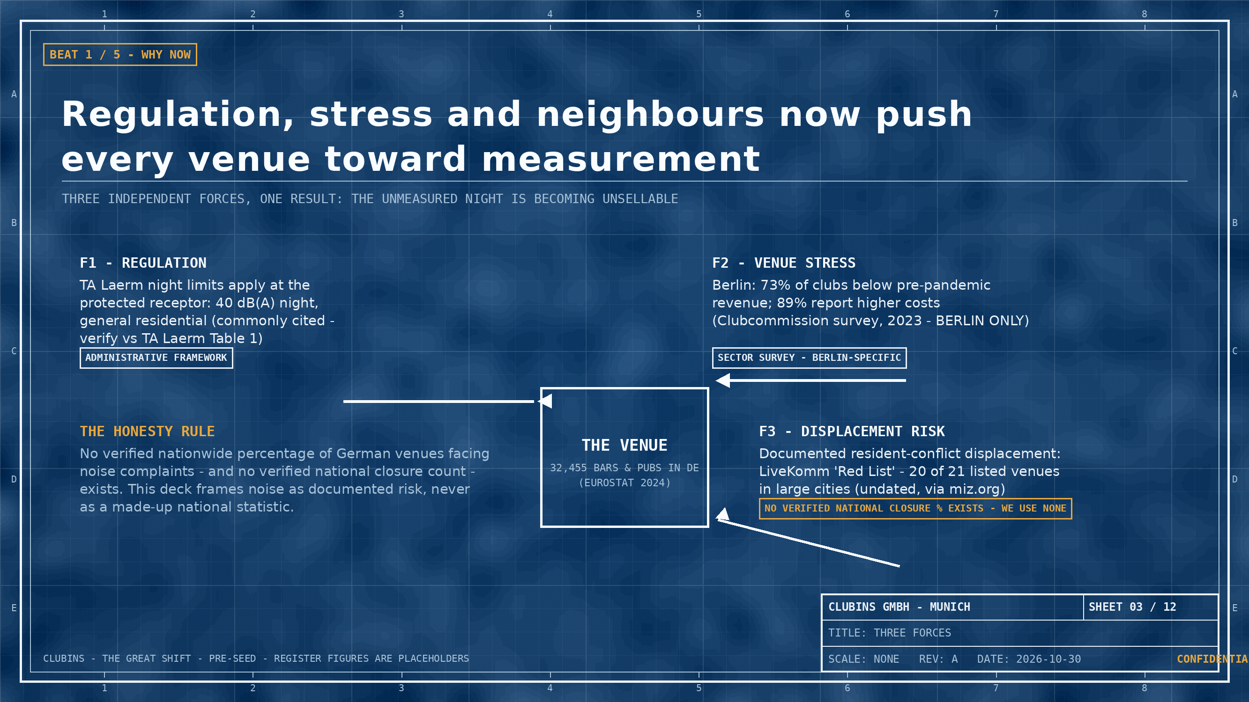
Notes:
BEAT 1 (CONTINUED) - FORCES. TA Laerm: nationwide administrative framework; limits commonly cited at the protected receptor - verify vs Table 1 before external use. Berlin figures: Clubcommission survey 2023 via miz.org - BERLIN ONLY. LiveKomm Red List via miz.org - undated, 20 of 21 listed venues in large cities. Honesty rule enforced: no national noise-closure statistic is claimed.

Slide 4
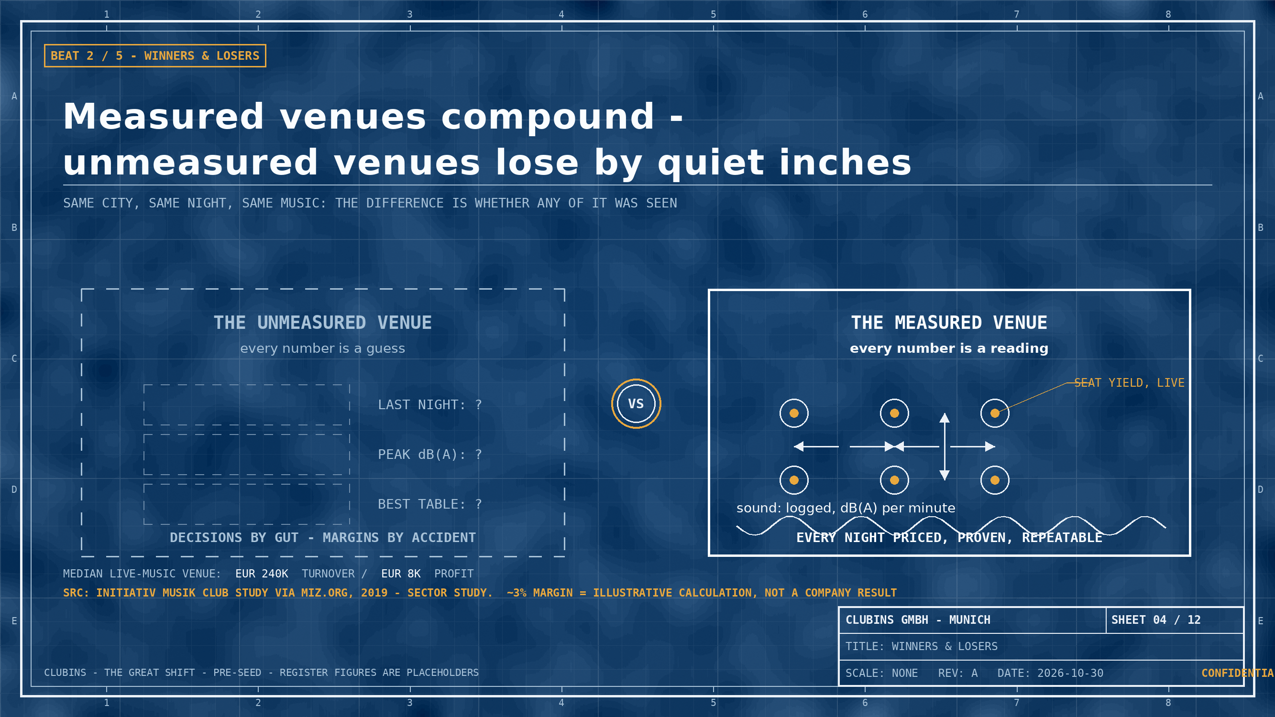
Notes:
BEAT 2 - WINNERS AND LOSERS OF THE SHIFT. VENUE ECONOMICS: MEDIAN TURNOVER EUR 240K / PROFIT EUR 8K (INITIATIV MUSIK CLUB STUDY VIA MIZ.ORG, 2019 - SECTOR STUDY). THE ~3% MARGIN IS AN ILLUSTRATIVE CALCULATION (8K/240K), LABELED AS SUCH - NOT A COMPANY RESULT.

Slide 5
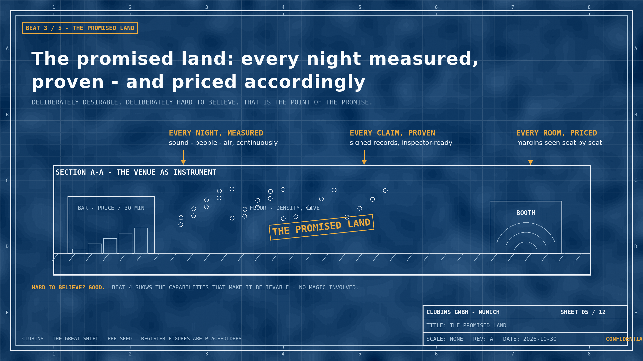
Notes:
BEAT 3 - TEASE THE PROMISED LAND. DESIRABLE AND HARD TO BELIEVE BY DESIGN. NO FIGURES ON THIS SHEET - THE PROMISE IS QUALITATIVE.

Slide 6
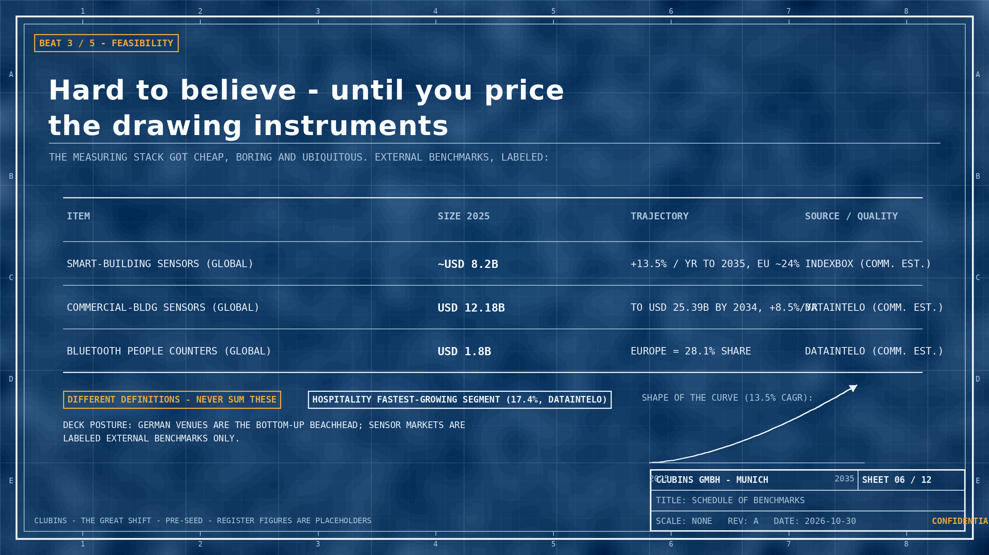
Notes:
BEAT 3 (REINFORCEMENT) - FEASIBILITY. BENCHMARKS: SMART-BUILDING SENSORS ~USD 8.2B 2025, 13.5% CAGR TO 2035, EUROPE ~24% (INDEXBOX); COMMERCIAL-BUILDING SENSORS USD 12.18B 2025 TO USD 25.39B 2034, 8.5% CAGR, HOSPITALITY 17.4% (DATAINTELO); BLUETOOTH PEOPLE COUNTERS USD 1.8B 2025, EUROPE 28.1% (DATAINTELO). ALL COMMERCIAL ESTIMATES, DIFFERENT DEFINITIONS - NEVER SUMMED.

Slide 7
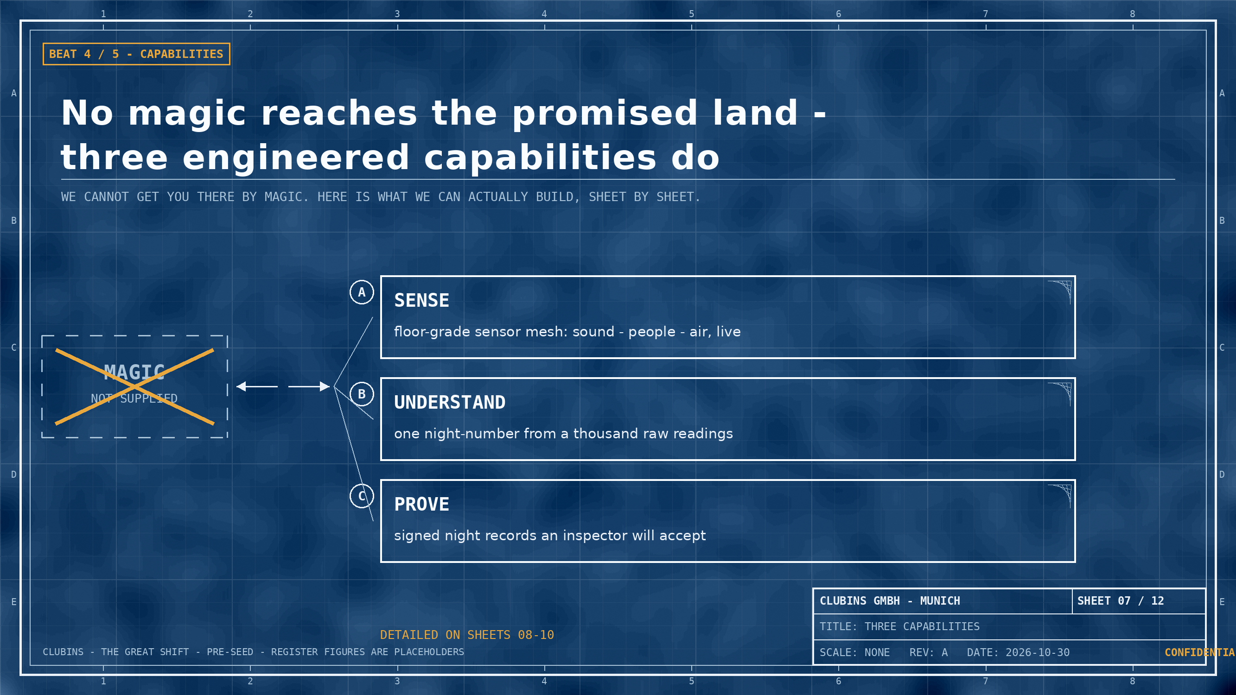
Notes:
BEAT 4 - CAPABILITIES, NOT MAGIC. RASKIN BEAT 4: FEATURES INTRODUCED AS MEANS ('MAGIC GIFTS') TO OVERCOME OBSTACLES EN ROUTE TO THE PROMISED LAND - EXPLICITLY NOT MAGIC. THREE PROOFS FOLLOW ON SHEETS 08-10. ARCHITECTURE CONTEXT: ESP32-S3 SENSORS, RUST FIRMWARE, GO INGESTION, CLICKHOUSE, FLUTTER DASHBOARDS, ZITADEL AUTH (PROJECT CONTEXT, NO FIGURES).

Slide 8
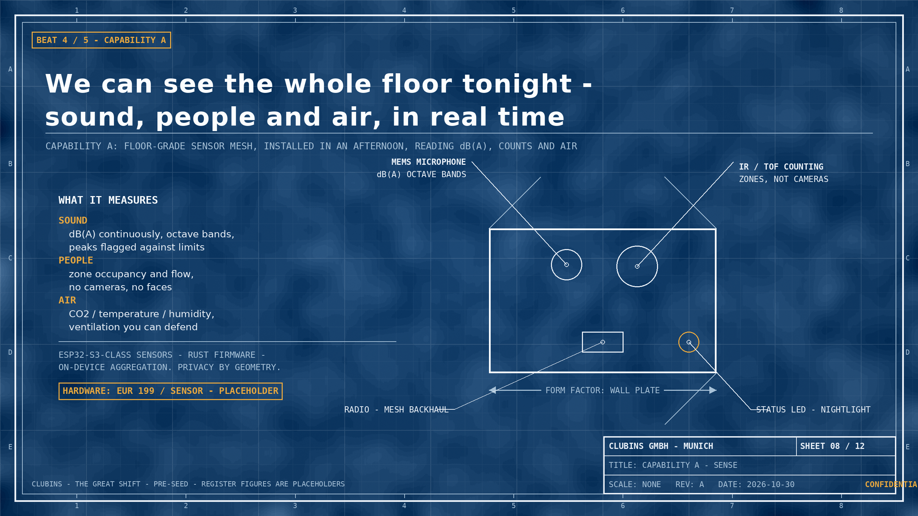
Notes:
BEAT 4 / CAPABILITY A - SENSE. HARDWARE PRICE EUR 199/SENSOR IS A REGISTER PLACEHOLDER (Hardware price, Value 199, EUR/sensor). SENSOR ARCHITECTURE (ESP32-S3, RUST FIRMWARE) IS PROJECT CONTEXT, NOT A CLAIM. NO INVENTED HARDWARE SPECS - FORM FACTOR LABEL IS GENERIC.

Slide 9
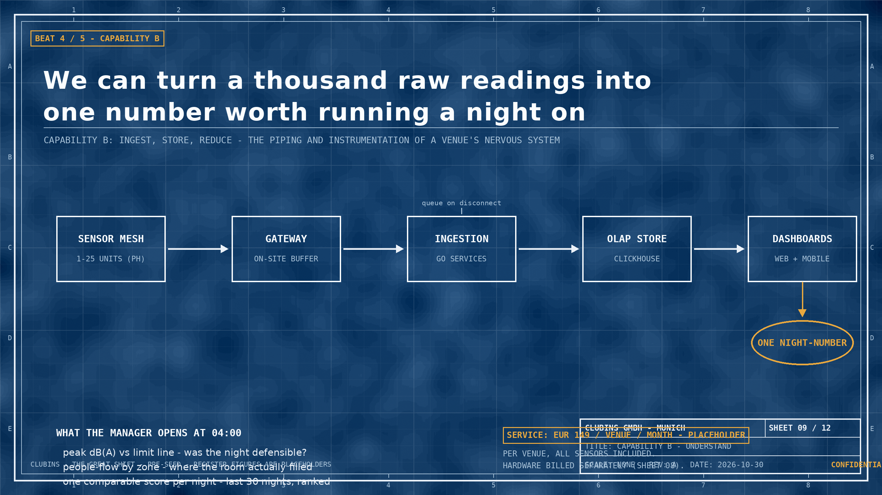
Notes:
BEAT 4 / CAPABILITY B - UNDERSTAND. PRICE EUR 149/VENUE/MONTH IS A REGISTER PLACEHOLDER (Price per venue, Value 149, EUR/month). '1-25 UNITS (PH)' CROSS-REFERS TO THE 25-SENSOR PLACEHOLDER USED ON SHEET 11. PIPELINE COMPONENTS (GO INGESTION, CLICKHOUSE, FLUTTER DASHBOARDS) ARE PROJECT CONTEXT.

Slide 10
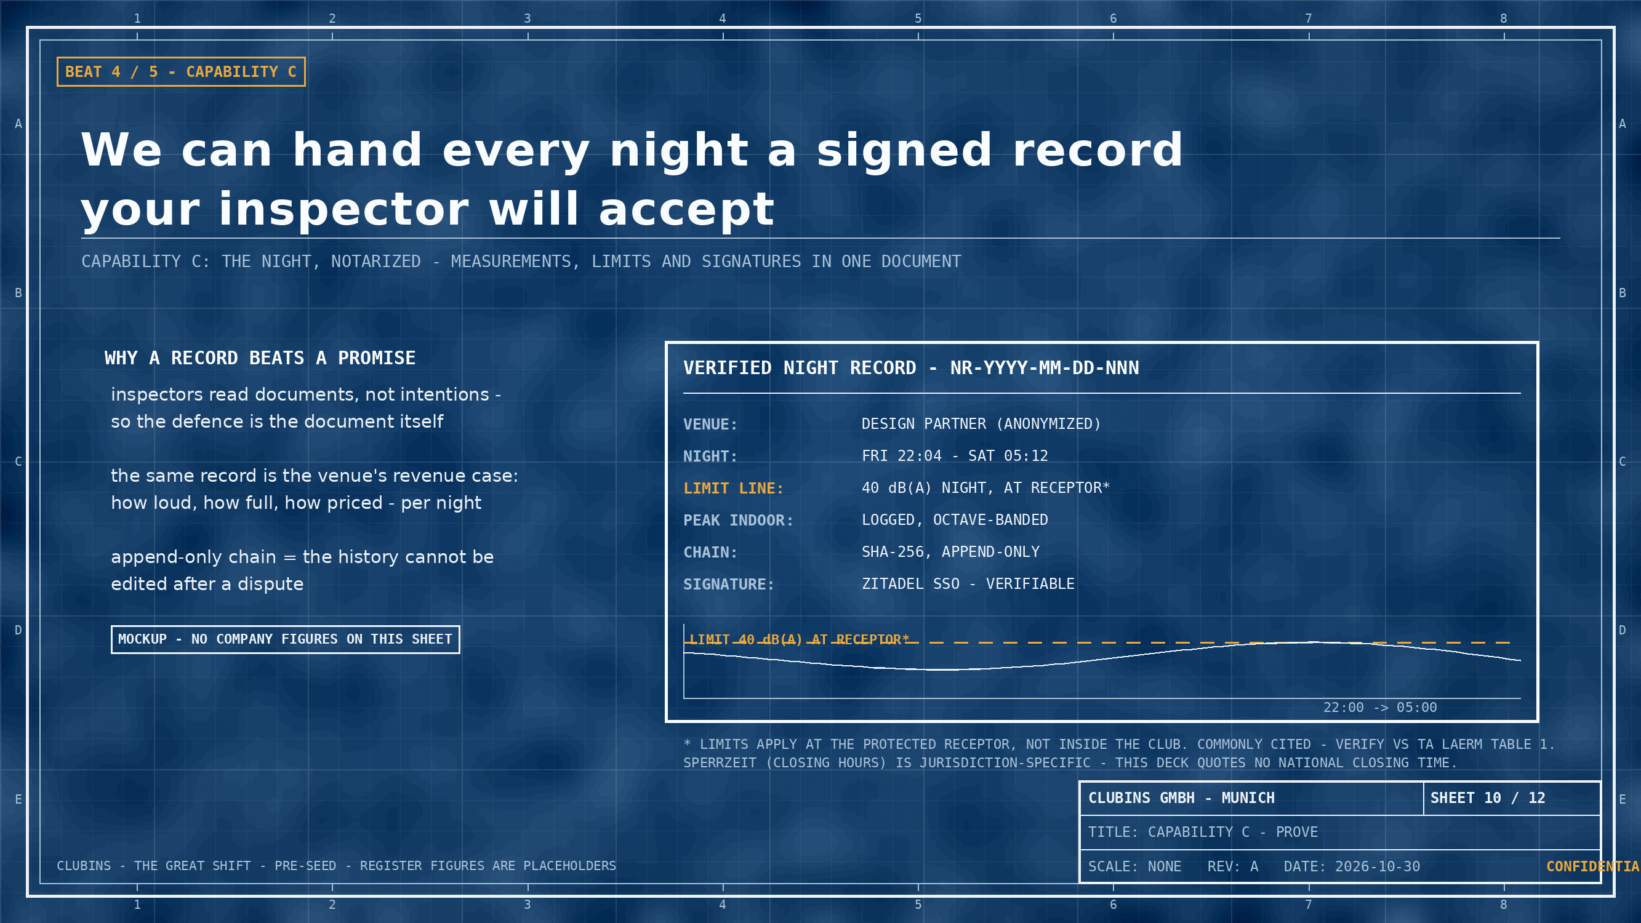
Notes:
BEAT 4 / CAPABILITY C - PROVE. TA Laerm night limit 40 dB(A) (general residential) is COMMONLY CITED - verify against Table 1 before external use; limits are at the receptor, not inside the club. Sperrzeit is jurisdiction-specific; no national closing time is quoted. The record is a mockup; no company figures appear.

Slide 11
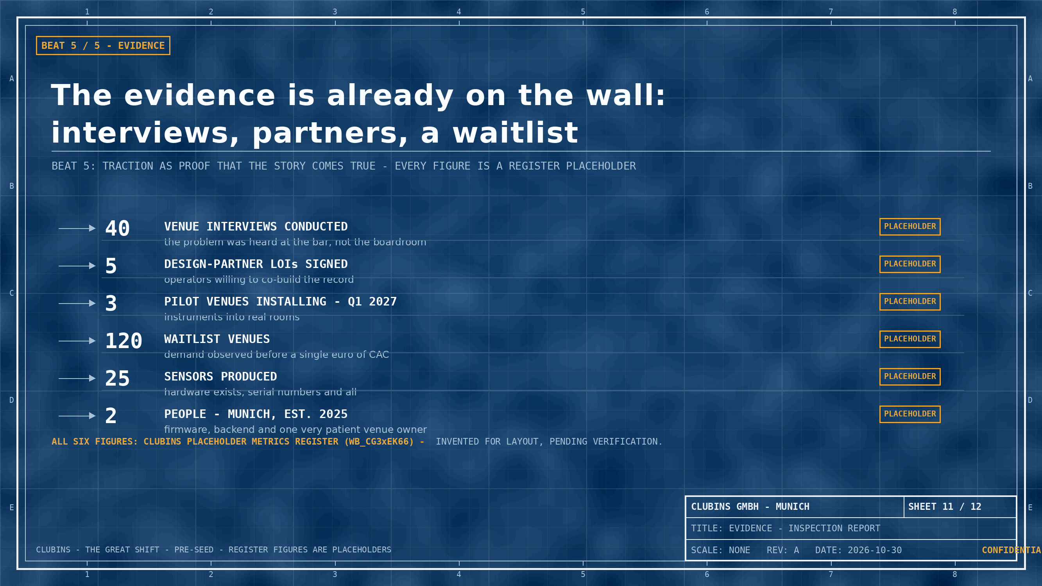
Notes:
BEAT 5 - EVIDENCE. REGISTER PLACEHOLDERS USED (Value / Unit): 40 venue interviews; 5 design-partner LOIs; 3 pilot venues (Q1 2027); 120 waitlist venues; 25 sensors produced; 2 team, founded 2025 (Munich). All marked PLACEHOLDER on-slide and in the register UsedIn column.

Slide 12
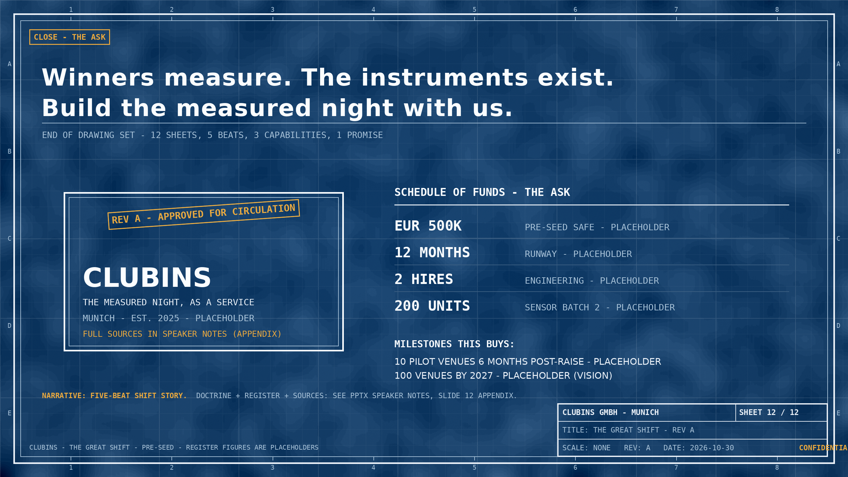
Notes:
APPENDIX NOTE - STORY DOCTRINE SOURCE: Andy Raskin, 'The Greatest Sales Deck I've Ever Seen' (2016), https://medium.com/the-mission/the-greatest-sales-deck-ive-ever-seen-4f4ef3391ba0 - the five beats: (1) name a big, relevant change in the world; (2) show there'll be winners and losers; (3) tease the promised land; (4) introduce features as 'magic gifts' for overcoming obstacles - not magic; (5) present evidence you can make the story come true. THIS DECK IMPLEMENTS THE BEATS IN ORDER ON SHEETS 02-11 (SHEET 01 = COVER, SHEET 12 = CLOSE/ASK). MARKET & REGULATION FACTS: 'Clubins Market & Regulation Facts (sourced)' doc (art_mYolRwiM) - Eurostat NACE I5630 2024 (32,455 bars & pubs; EUR 8.049B turnover); Initiative Musik Club Study via miz.org 2019 (median EUR 240K turnover / EUR 8K profit); Clubcommission Berlin survey 2023 (73% / 89%, BERLIN ONLY); TA Laerm commonly cited receptor limits (40 dB(A) night, general residential) - verify vs Table 1; LiveKomm Red List (20 of 21, undated); IndexBox + DataIntelo commercial estimates (never summed). COMPANY FIGURES: ALL FROM THE PLACEHOLDER METRICS REGISTER (wb_cg3xEK66, sheet sh_vpK5zAbf), each marked PLACEHOLDER on-slide: founded 2025, team 2, interviews 40, LOIs 5, pilots 3, waitlist 120, sensors 25, price/venue EUR 149/mo, hardware EUR 199/sensor, ask EUR 500K, runway 12 mo, hires 2, batch 2 = 200 units, pilot target 10, 2027 target 100.

